Slide 1
Class Relationships

Slide 2

In this topic you will learn about
Association.
Aggregation.
Composition.
Multiplicity.
Implementing Java Programming with association, aggregation, composition & multiplicity.

Slide 3

Relationship
The relationship allows object to call method in other object or used the data member from different object.
Types of relationship:
  Association.
  Aggregation.
  Composition.
  Generalization / inheritance

Slide 4
Association
Association represents a general relationship that describes an activity between two classes.
It is implemented by passing object to a method – pass by reference.
In the UML, an association is represented by a solid line with or without an arrow.
Association can be a one way association or bi-directional association.

Slide 5
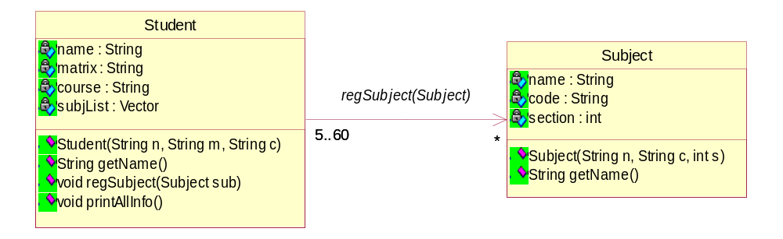
Association: 1st. Case
getStudentName()
getSubjectName()
An association is usually represented as an attribute / a data field in the class.
public class Student
{ Subject[] subj=new Subject[5];
/*attributes*/
/*methods*/}
public class Subject
{/*attributes*/
/*methods*/}

Slide 6
Association: 1st. Case Example
import java.util.*;
class Association{
public static void main(String args[]){
Subject[] subj= new Subject[5];
subj[0] = new Subject("OOP", "DCS2133",03); subj[1] = new Subject("DATA STRUCT","DCP2023",01);
Student s1 = new Student("ali","DC0021","2DCS");
Student s2 = new Student("abu","DC0022","3DCS");
Student s3 = new Student("ben","DC0023","3SCS");
s1.regSubject(subj);
s2.regSubject(subj);
s3.regSubject(subj);
s1.printAllInfo(subj);
s2.printAllInfo(subj);
s3.printAllInfo(subj); }}

Slide 7
Association: 1st. Case Example (cont.)
class Student{
String name;
String matrix;
String course;
Student(String n,String m,String c){
name=n;
matrix=m;
course=c;
}
public String getStudentName(){ return name; }
public void regSubject(Subject[] subj) //showing association
{printAllInfo(subj);}
}

Slide 8
public void printAllInfo(Subject[] subj)
{
System.out.println("\nSTUDENT NAME :"+name);
System.out.println("NUMBER OF SUBJECT(s) TAKEN :"+subj.size());
System.out.println("LIST OF SUBJECT(s) TAKEN :");
for(int i=0;i<subj.size();i++){
System.out.println(subj[i].getSubjectName());
}
}
}//Student

Slide 9
class Subject{
String name;
String code;
int section;
Subject(String n,String c,int s)
{ name = n;
code = c;
section =s;
}
public String getName()
{
return name;
}}//Subject

Slide 10
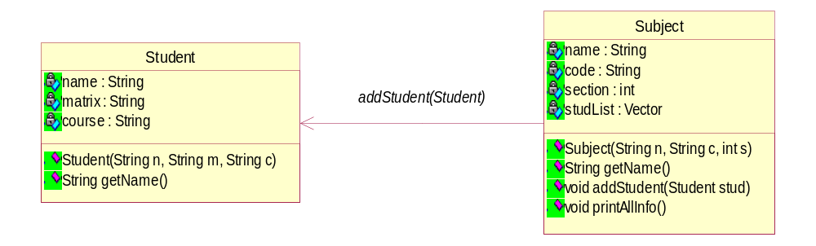
Association: 2nd. Case
getStudentName()
getSubjectName()
public class Student
{/*attributes*/
/*methods*/}
public class Subject
{Student[] stud=new Student[5];
/*attributes*/
/*methods*/}

Slide 11
Association: 2nd. Case Example
import java.util.*;
class Association{
public static void main(String args[]){
Subject subj1 = new Subject("OOP","SCP3103",03);
Subject subj2 = new Subject("DATA STRUCT","DCP2023",01);
Student[] s=new Student[5];
s[0] = new Student("ali","DC0021","2DCK");
s[1] = new Student("abu","DC0022","3DCK");
s[2] = new Student("ben","DC0023","3SCK");
subj1.addStudent(s);
subj2.addStudent(s);
subj1.printAllInfo(s);
subj2.printAllInfo(s);}}

Slide 12
Association: 2nd. Case Example (cont.)
class Subject{
String name;
String code;
int section;
Subject(String n,String c,int s){
name = n;
code = c;
section =s;
}
public String getSubjectName(){ return name; }
public void addStudent(Student[] stud)
{printAllInfo(stud); }

Slide 13
public void printAllInfo(Student[] stud){
System.out.println("\nSUBJEK :"+name);
System.out.println("NUMBER OF STUD REGISTERED :"+stud.size());
System.out.println("LIST OF STUD REGISTERED :");
for(int i=0;i<stud.size();i++){
System.out.println(stud[i].getStudentName());
}
}
}//Subject

Slide 14
class Student{
String name;
String matrix;
String course;
Student(String n,String m,String c){
name=n;
matrix=m;
course=c;
}
public String getStudentName(){
return name;
}
}//Student

Slide 15
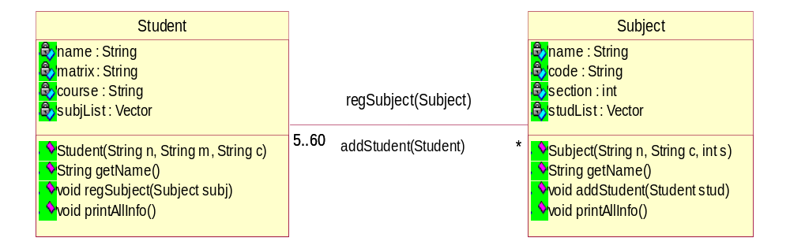
Association: 3rd. Case
getStudentName()
getSubjectName()
This is a bi-directional association.
public class Student
{ Subject[] subjList=new Subject[5];
/*attributes*/
/*methods*/}
public class Subject
{Student[] studList=new Student[5];
/*attributes*/
/*methods*/}

Slide 16
Association: 3rd. Case Example
import java.util.*;
class Association4{
public static void main(String args[]){
Subject subj1 = new Subject4("OOP","SCP3103",03); Subject subj2 = new Subject4("DATA STRUCT", "DCP2023", 01);
Student[] s=new Student[5];
s[0] = new Student4("ali","DC0021","2DCK");
s[1] = new Student4("abu","DC0022","3DCK");
s[2] = new Student4("ben","DC0023","3SCK");
subj1.addStudent(s);
subj2.addStudent(s);
subj1.printAllInfo(s);
subj2.printAllInfo(s);
s[0].printAllInfo(subj1);
s[1].printAllInfo(subj1);
s[2].printAllInfo(subj2); }}

Slide 17
class Subject{
String name;
String code;
int section;
Subject4(String n,String c,int s){
name = n;
code = c;
section =s;
}
public String getSubjectName(){ return name; }
public void addStudent(Student[] stud){
printAllInfo(stud); /*make 2-way association*/
for(int i=0; i<stud.length;i++) {
stud[i].regSubject(this); }}//addStudent

Slide 18
public void printAllInfo(Student[] stud){
System.out.println("\nSUBJEK :"+name);
System.out.println("NUMBER OF STUD REGISTERED :"+stud.length());
System.out.println("LIST OF STUD REGISTERED :");
for(int i=0;i<stud.length;i++){
System.out.println(stud[i].getStudentName());
}
}
}

Slide 19
class Student{
String name;
String matrix;
String course;
Student(String n,String m,String c){
name=n;
matrix=m;
course=c;
}
public String getStudentName(){ return name; }
public void regSubject(Subject subj){
printAllInfo(subj) }//regSubject

Slide 20
public void printAllInfo(Subject sub){
System.out.println("\nSTUDENT NAME :"+name);
System.out.println(sub.getSubjectName());
}
}
}

Slide 21
Aggregation
A special form of association also known as aggregation association.
A type of association where a whole is related to its part(s)
Represents an ownership relationships between two classes.
Models the relationship like has-a, part-of, owns.
Parts exist independent of whole.
Parts and whole have independent lifetimes.
Parts may belong to multiple wholes.
Parts may change during execution
Anti-symmetric (i.e. one way)
  If A is part of B, B cannot be part of A.

Slide 22
Aggregation
In the UML, an aggregation is represented by a solid line with or without an arrow on one end and hollow diamond at the end of the aggregate (whole).

Slide 23
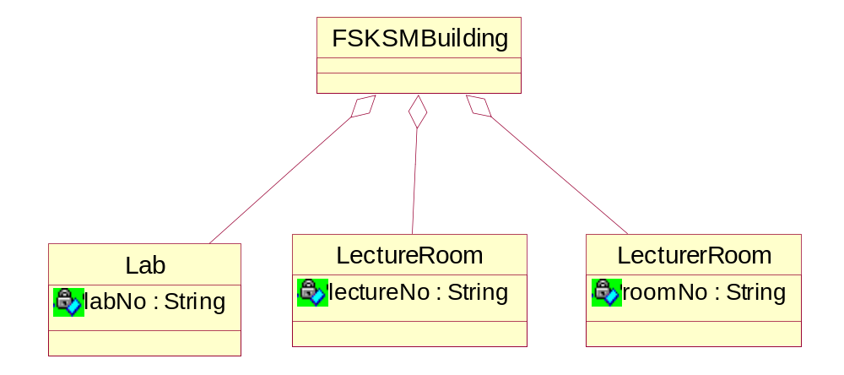
Aggregation: Example
FSKKPBuilding
public class FSKKPBuilding
{ private Lab lab1;
private LectureRoom lect;
private LecturerRoom lectr;
}

Slide 24
Aggregation: Example
class Lab {public String labNo;}
class LectureRoom { public String lectureNo;}
class LecturerRoom { public String roomNo;}
class FSKKPBuilding{
private Lab makmal;
private LectureRoom bilikKuliah;
private LecturerRoom bilikPensyarah;
public FSKKPBuilding(String _labNo,String _lectureNo, String _roomNo){
makmal = new Lab();
bilikKuliah = new LectureRoom();
bilikPensyarah = new LecturerRoom();
makmal.labNo= _labNo;
bilikKuliah.lectureNo= _lectureNo;
bilikPensyarah.roomNo= _roomNo; }}

Slide 25
class TestAggregate{
public static void main(String args[])
{
FSKKPBuilding fskkp=new FSKKPBuilding("KPU8","BK2","306-02");
System.out.println("Makmal OOP ialah di "+ fskkp.makmal.labNo +"\n"+
"Bilik Kuliah di "+" "+fskkp.bilikKuliah.lectureNo + "\n"+"Bilik Pensyarah di "+ fskkp.bilikPensyarah.roomNo);
}
}

Slide 26
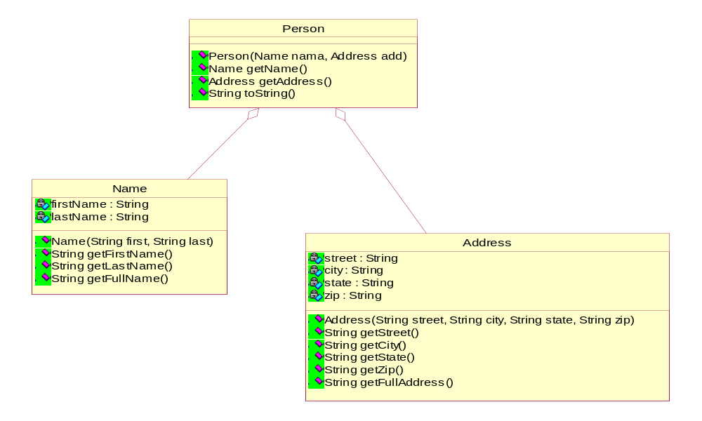
Aggregation: Example 2

Slide 27
Aggregation: Example 2
public class Name
{ private String firstName;
private String lastName;
public Name(String firstName, String lastName)
{ this.firstName=firstName;
this.lastName=lastName;
}
public String getFirstName()
{ return firstName;}
public String getLastName()
{ return lastName;}
public String getFullName()
{ return firstName + ' ' + lastName;}}

Slide 28
public class Address
{ private String street; private String city;
private String state; private String zip;
public Address(String street, String city, String state, String zip)
{ this.street=street;
this.city=city;
this.state=state;
this.zip=zip; }
public String getStreet()
{ return street;}
public String getCity()
{ return city;}
public String getState()
{ return state;}
public String getZip()
{ return zip;}
public String getFullAddress() {return street +'\n' + city+ ", " +state+ ' ' +zip ; }}

Slide 29
public class Person
{ private Name name;
private Address address;
public Person(Name name, Address address)
{ this.name=name;
this.address=address; }
public Name getName()
{ return name;}
public Address getAddress()
{ return address;}
public String toString()
{return '\n' +name.getFullName() +'\n' +address.getFullAddress() +'\n'; }
}

Slide 30
public class TestPerson
{
public static void main(String []a)
{
Name nama = new Name("ALI", "Ahmad");
Address add = new Address("Jalan A","Skudai","Johor","81300");
Person persona = new Person(nama, add);
System.out.println(persona.toString());
}
}

Slide 31
Association or Aggregation?
If two objects are tightly bound by a whole –part relationship, then the relationship is an aggregation. Example: StudentClub or Car
If two objects are usually considered as independent, although they are often linked, then the relationship is an association. Exemple Student & Book.
When in doubt…. use association.

Slide 32
Composition
Form of aggregation.
For a relationship: “contains a”.
Strong ownership / binding.
Parts belong to one whole.
Parts cannot survive without whole/aggregate
In the UML, an aggregation is represented by a solid line with or without an arrow on one end and solid diamond at the end of the aggregate (whole).
Example: BankCustomer & Account.

Slide 33

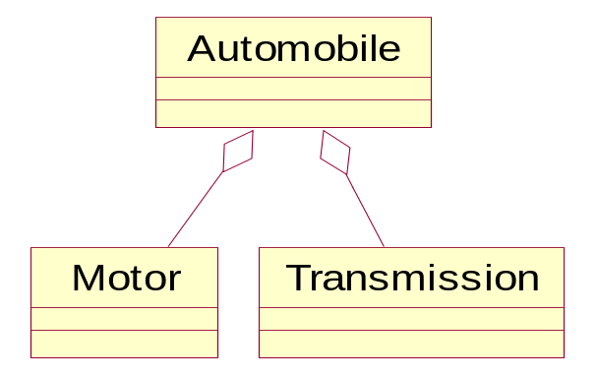
public class Automobile
{
Private Transmission drive = new Transmission();
Private Motor engine = new Motor();
}

Slide 34
Aggregation or Composition?
A part exist after the whole is exist.
A part is also gone when the whole is gone.

Slide 35
Exercise
Draw the UML class diagram and its relationship between the following classes.
  PetrolStation, Car, Passenger, CarFrame.
  RentalAggreement, House.
  Husband, Wife & Marriage.

Slide 36
Multiplicity
Multiplicity demonstrates how many possible objects are involve in each role of association.
The multiplicity of an association end is the number of possible object of the class associated with a single object of the other end.
Example: one student can have from zero or more books

Slide 37
The common multiplicity
Multiplicities
1 or left blank -usually blank | Exactly one instance
0..* or * | Many (Zero or more instance)
1..* | One or more (At least one instance)
0..1 | Optional (Zero or one instance)

Slide 38
Exercise
Put the multiplicity for the following classes together with their relationship.
  PetrolStation, Car, Passenger, CarFrame.
  RentalAggreement, House.
  Husband, Wife & Marriage.

